Slide 1
EXPLORATORY ANALYSIS ON
FORMULA 1 RACING
BY
ADETUNJI, Babajide Samuel
ALT/SOD/023/0525

Slide 2
DATABASE OVERVIEW AND METHODOLOGY
The Formula 1 dataset used in this analysis was gotten from kaggle.com, the data was collected from 2000 - 2024.
https://www.kaggle.com/datasets/henriquerezermosqur/formula-one-data-2000-2024/code
The approach used for this analysis is PowerBI.

Slide 3
OBJECTIVES OF THE STUDY
Identify number of circuits by various countries.
Most top 3 constructor finishes.
Most constructor points.
Drivers Nationality
Drivers points difference between first and second.
Drivers most win and most points.
DNF status(Did not finish Status)

Slide 4
Nations with the most driver winners.
Average pitstops time.
Most wins,points in qualifying round.
Compare grid with where they finish.

Slide 5
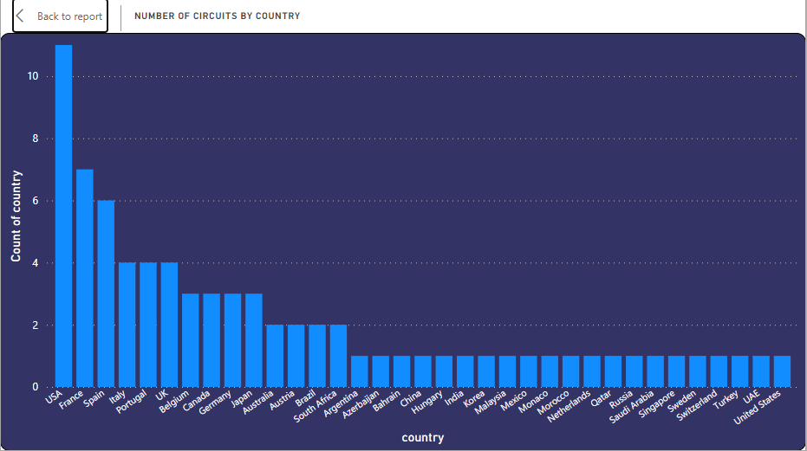
DATA ANALYSIS
Number of circuits by country

Slide 6
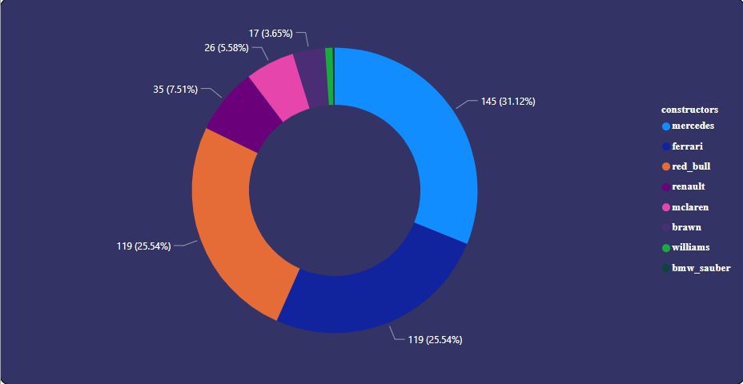
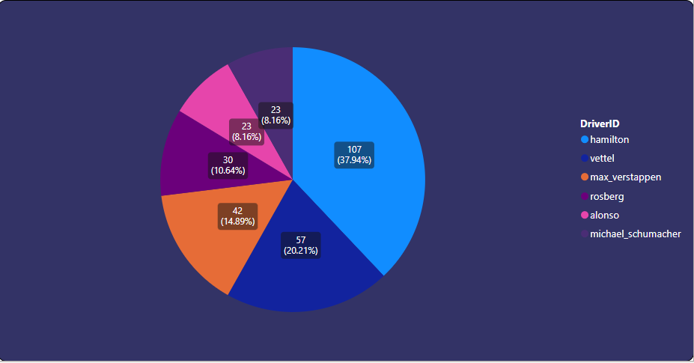
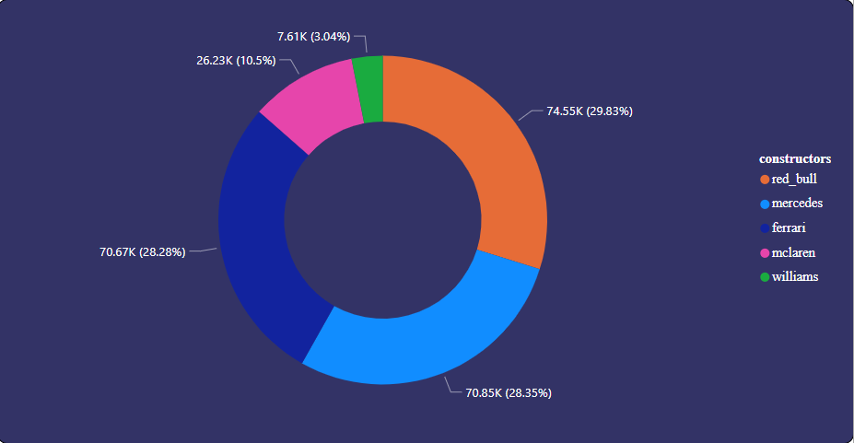
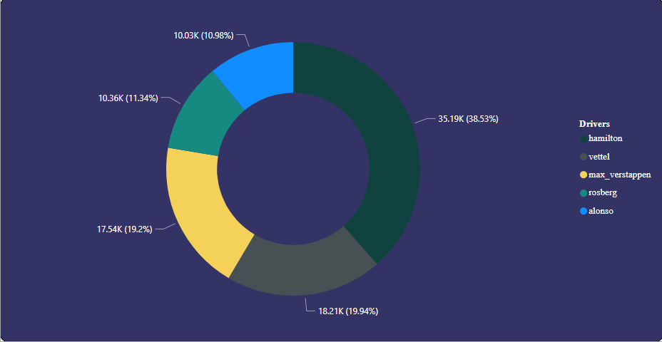
Most constructor wins
Most wins by drivers in qualifying round
Most constructor points
Most Driver points

Slide 7
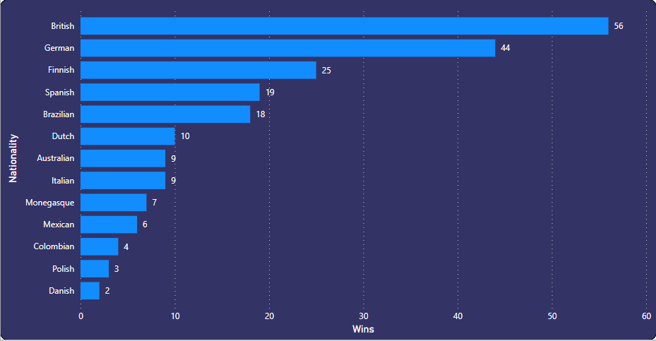
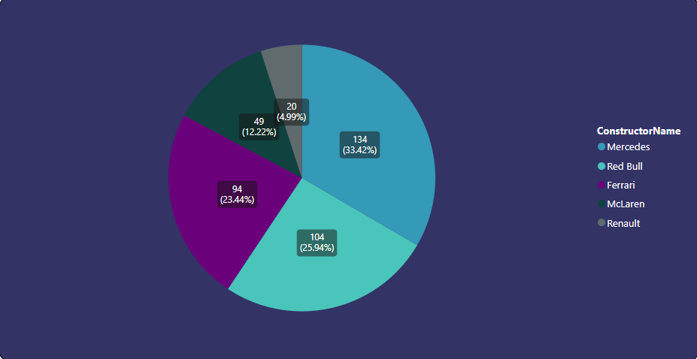
Nations with most driver win
Most constructor wins in qualifying round
This shows the top 5 constructors with the most wins in qualifying stages.
This shows the nations with most driver wins in the formula 1 between 2000 - 2004.

Slide 8
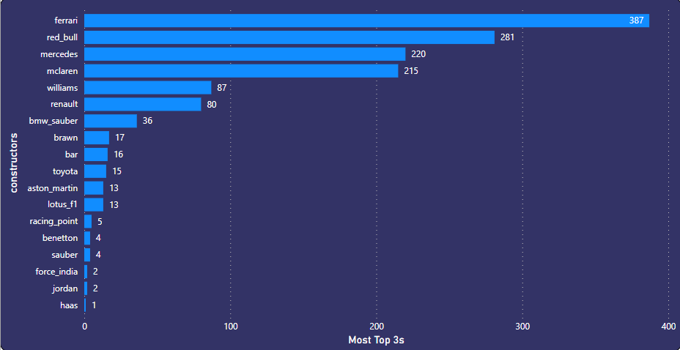
Most top 3 wins by constructor

Slide 9
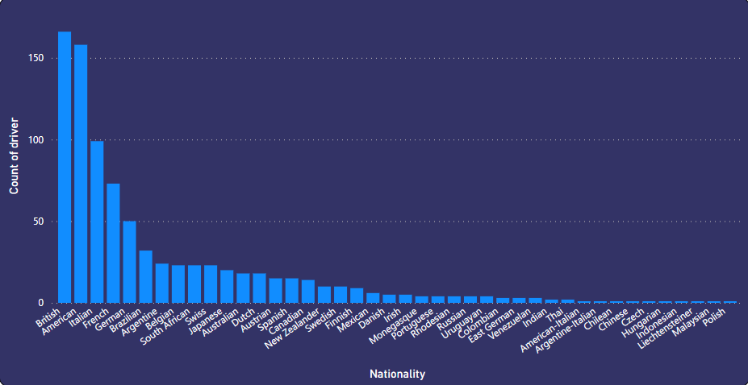
Country with most driver

Slide 10
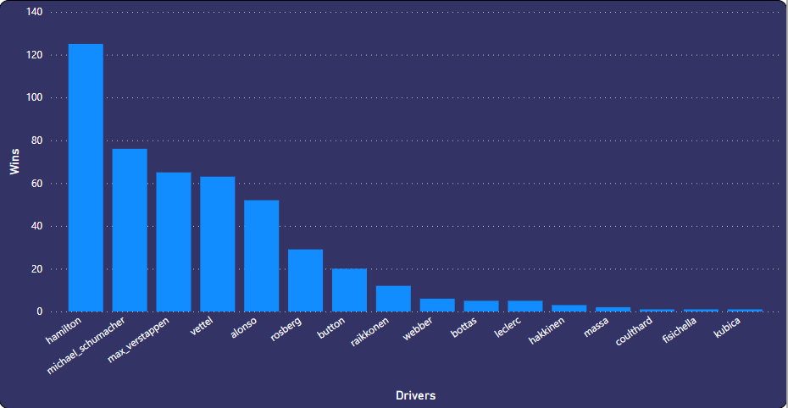
Drivers with most wins
From the graph above ,between 2000 - 2024 we can see that Hamilton is GOAT of F1.

Slide 11
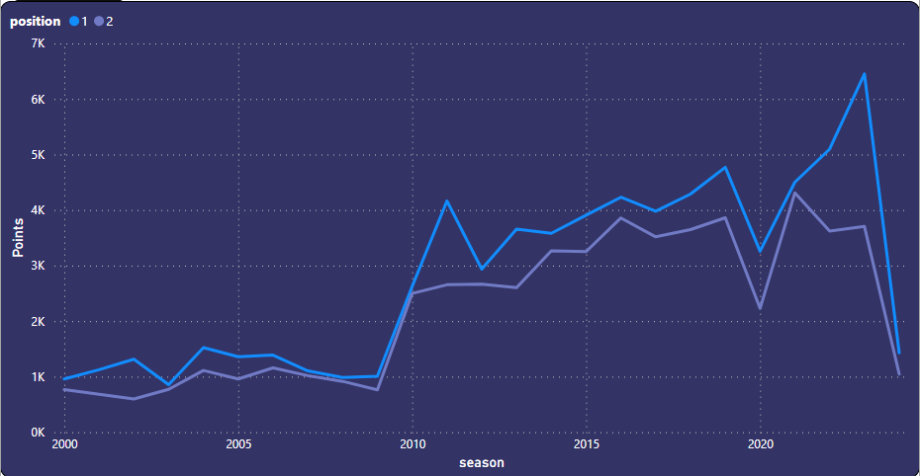
Drivers point trend(difference between 1 and 2)
Trend shows the difference in points between first position and second position over the years.

Slide 12
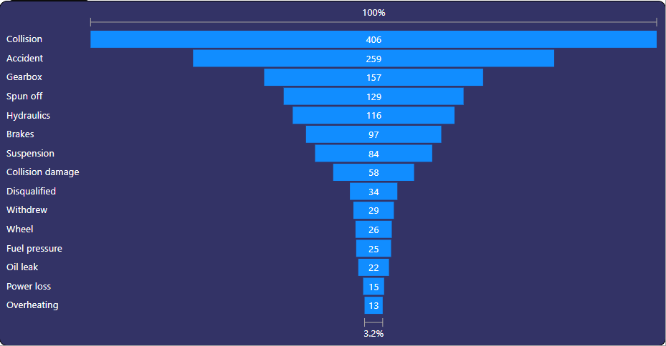
DNF Status (Did not finish status)
This helps us understand the status and reasons most drivers don’t finish the races ,also helps the driver and constructor crews know what to look at before going in a race.

Slide 13
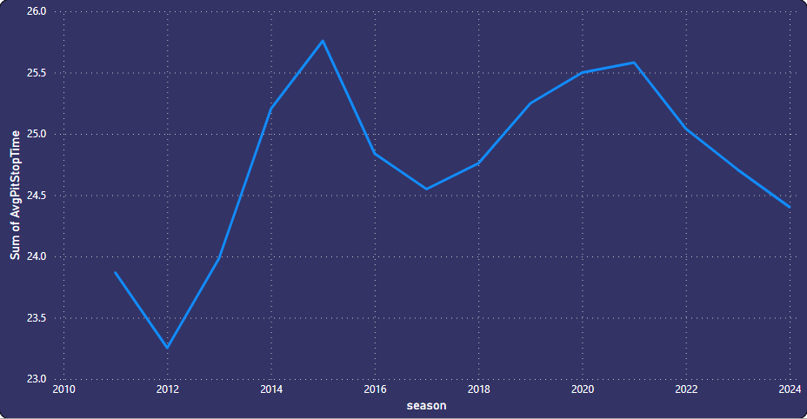
Average pitstop time over the years
Pitstop times are very important in racing as races are frequently lost and won because of pit stops and pit crew, as a few seconds stop can give the opponent few hundred meters advantage.
This is the average pit stop times over the years and we can see a significant rise as the years go by.

Slide 14
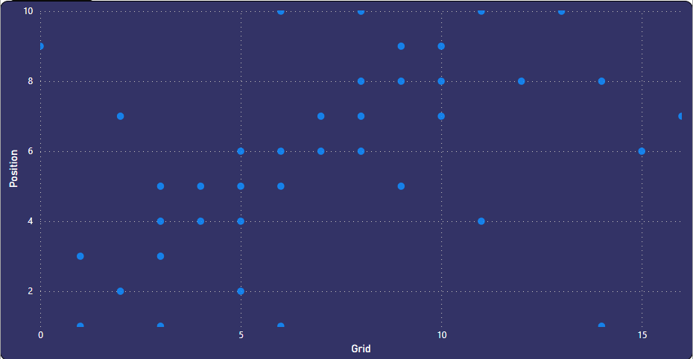
Comparing Grids and position
Took a sample data from 2020 - 2024 to compare the Grid position(i.e the starting position by drivers determined in the qualifying round) to the final position in the race. To see how grid positions affect the final result.
We can see from the plot that most of the times grid position matters in the race as it give drivers a little advantage.

Slide 15
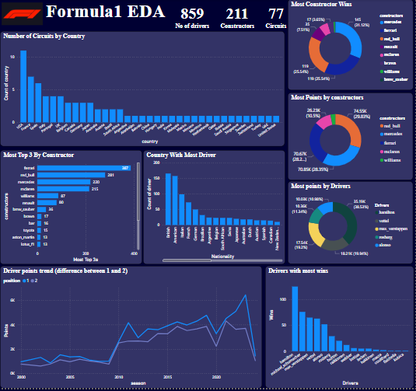

Slide 16
